Slide 1

Company Financial Decoding: A Clearer Picture
Discover valuable insights and gain a deeper understanding of company financials with this comprehensive website.

Slide 2
Understanding Financial Statements
Balance Sheet
Income Statement
Cash Flow Statement
A snapshot of a company's assets, liabilities, and equity at a specific point in time.
Summarizes a company's revenues and expenses over a period of time, revealing profitability.
Tracks the movement of cash both into and out of a company during a period.

Slide 3
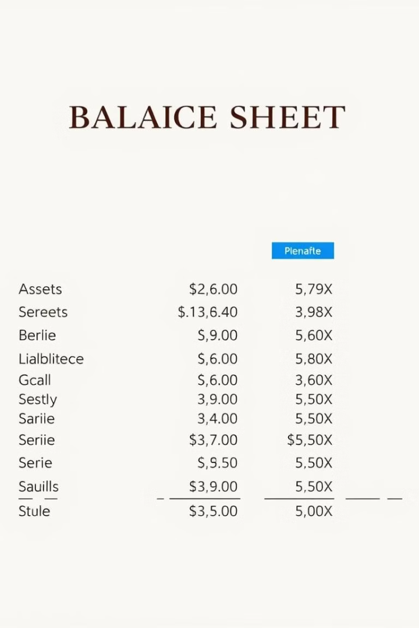
Analyzing the Balance Sheet
Assets
Liabilities
Resources owned by the company that have future economic benefit.
Obligations of the company to outside parties, including loans and accounts payable.
Equity
The residual value of the company after all liabilities are paid off, representing ownership claims.

Slide 4
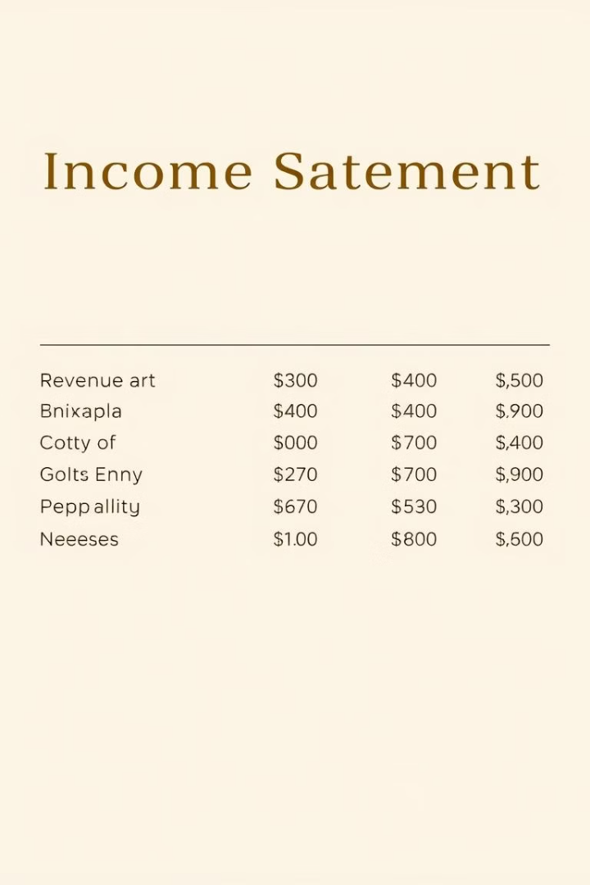




Interpreting the Income Statement
Revenue
Cost of Goods Sold
Operating Expenses
The total amount of money a company earns from its products or services.
The direct costs associated with producing and delivering goods or services.
Indirect costs involved in running a business, such as rent, salaries, and utilities.
Net Income
The profit or loss a company generates after deducting all expenses from revenue.

Slide 5
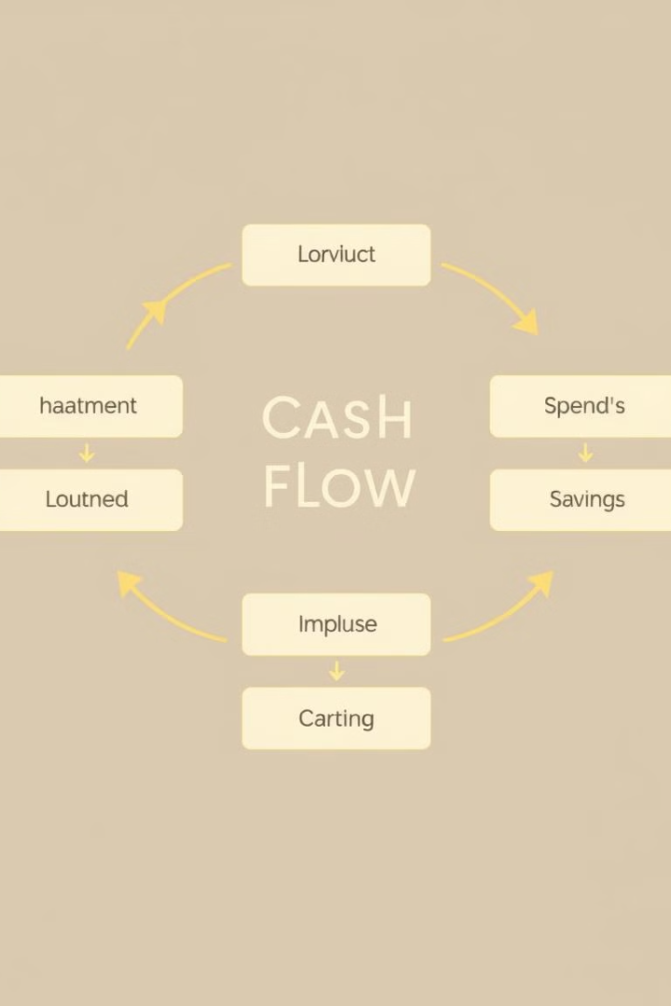
Evaluating Cash Flow Statements
1
Operating Activities
Cash flows from the company's core business operations.
2
Investing Activities
Cash flows related to the purchase and sale of long-term assets.
3
Financing Activities
Cash flows related to funding the business, such as debt or equity financing.

Slide 6
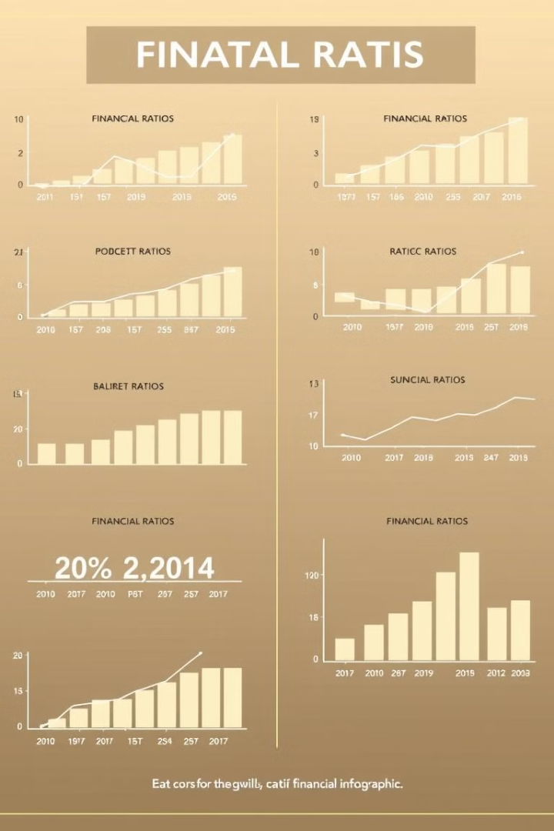




Key Financial Ratios and Metrics
Profitability Ratios
Measure a company's ability to generate profits.
Liquidity Ratios
Show a company's ability to meet short-term financial obligations.
Solvency Ratios
Assess a company's long-term financial health and ability to repay debts.
Valuation Ratios
Compare a company's market value to its financial performance.

Slide 7

Identifying Growth Opportunities
Market Analysis
Identify expanding markets and emerging trends.
Competitive Analysis
Assess strengths and weaknesses of competitors.
Financial Planning
Develop a strategic plan for growth, including capital allocation.
Investment Strategies
Consider potential investments and acquisitions to drive expansion.

Slide 8

Conclusion and Next Steps
Armed with this knowledge, you can confidently navigate the complexities of financial analysis and make informed decisions based on reliable insights.

